Slide 1
Sampling methods
This presentation is based on L.V. Graduer “Stratification” materials: https://stepik.org/media/attachments/lesson/26213/strata.pdf

Slide 2
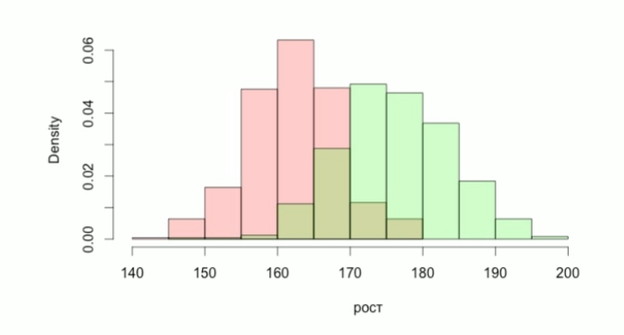
Stratification:
Population height.
Female 54%, Man 46%
Height

Slide 3
Stratification examples:
Population can be grouped into clusters (or stratas) basing on geographic location;
Internet users – by a browser used;
Financial transactions – by transaction scale: large, medium, small.

Slide 4

A mixture of distributions:
Let
$$ξ\sim F\left(x\right)=W_{1}F_{1}\left(x\right)+…+W_{L}F_{L}\left(x\right)$$
$W_{k}$ - strata’s ratio, $k=\overline{1,L}$
Let:
$μ=E$ $ξ$
$$σ^{2}=Dξ$$
$μ_{k}$ - expected value of kth strata
$σ_{k}^{2}$ - variance of kth strata

Slide 5
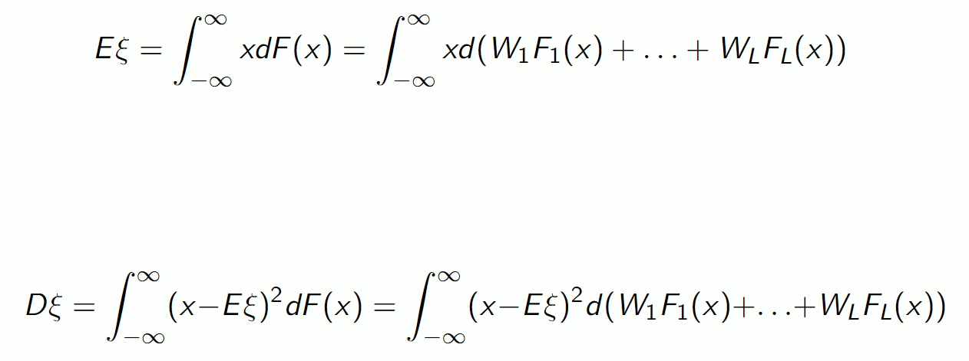
Expected value and variance:

Slide 6

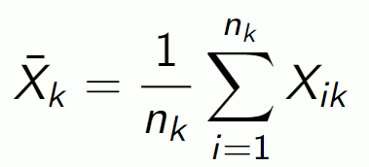
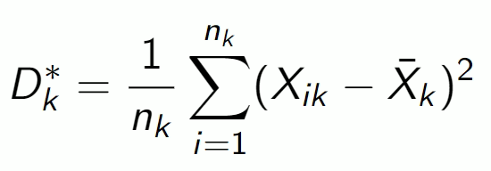
Stratified samples:
Within the kth strata let’s take a sample of volume nk:
Then it’s sample mean:
It’s sample variance:

Slide 7
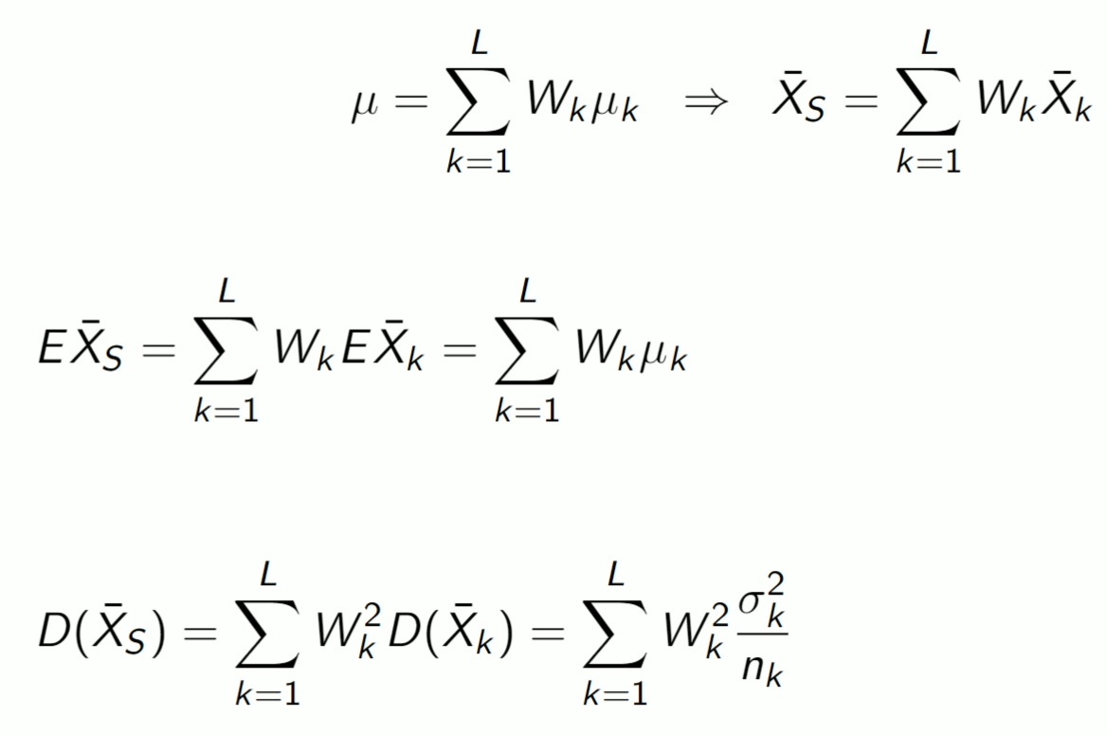
Mean expectation estimation for a mixture:
- mixture sample mean
- EV of mixture sample mean
- Variance of mixture sample mean

Slide 8
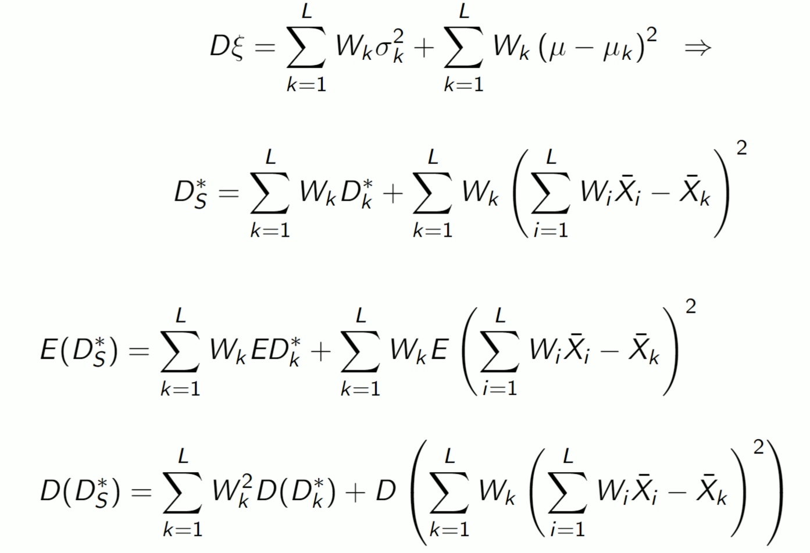
Variance estimation for a mixture:
- mixture sample variance
- EV of mixture sample variance
- Variance of mixture sample variance

Slide 9
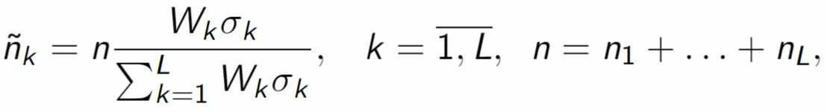


How to choose sample volumes of stratas?
Theorem for Neyman allocation (so-called Optimal sampling):
Sample volumes n1,…,nL those
minimize variance .
So, for strata k with volume nk the resulted sample volume will be $\tilde{n_{k}}.$
Proportional sampling:

Slide 10
Why use stratas?
To reduce variance for estimation of unknown parameters
To add objects from different stratas in a sample (it may not happen with plain random sampling)

Slide 11
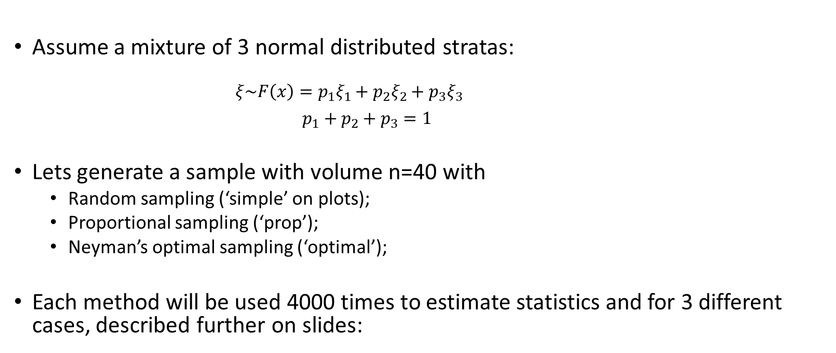
Example:
Assume a mixture of 3 normal distributed stratas:
$$ξ\sim F\left(x\right)=p_{1}ξ_{1}+p_{2}ξ_{2}+p_{3}ξ_{3}$$
$p_{1}+p_{2}+p_{3}=1$
Lets generate a sample with volume n=40 with
Random sampling (‘simple’ on plots);
Proportional sampling (‘prop’);
Neyman’s optimal sampling (‘optimal’);
Each method will be used 4000 times to estimate statistics and for 3 different cases, described further on slides:

Slide 12
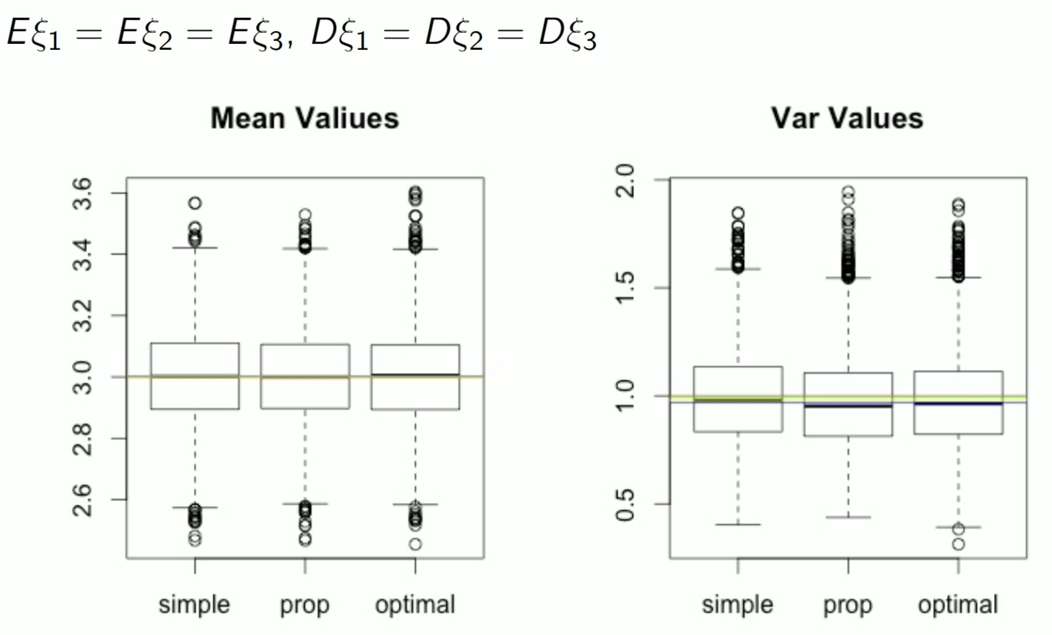
1. Equal EV and equal variances:

Slide 13
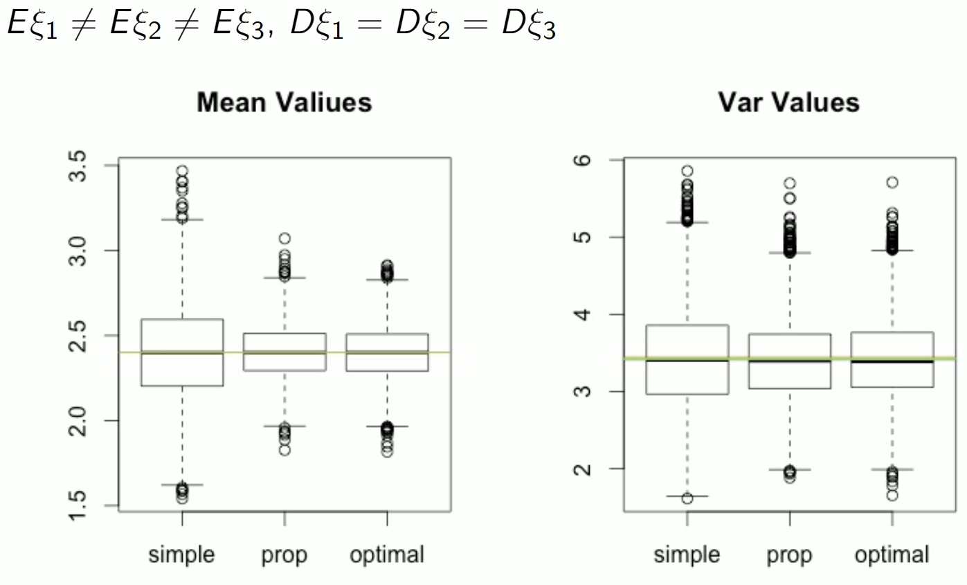
2. Different EV and equal variances:

Slide 14
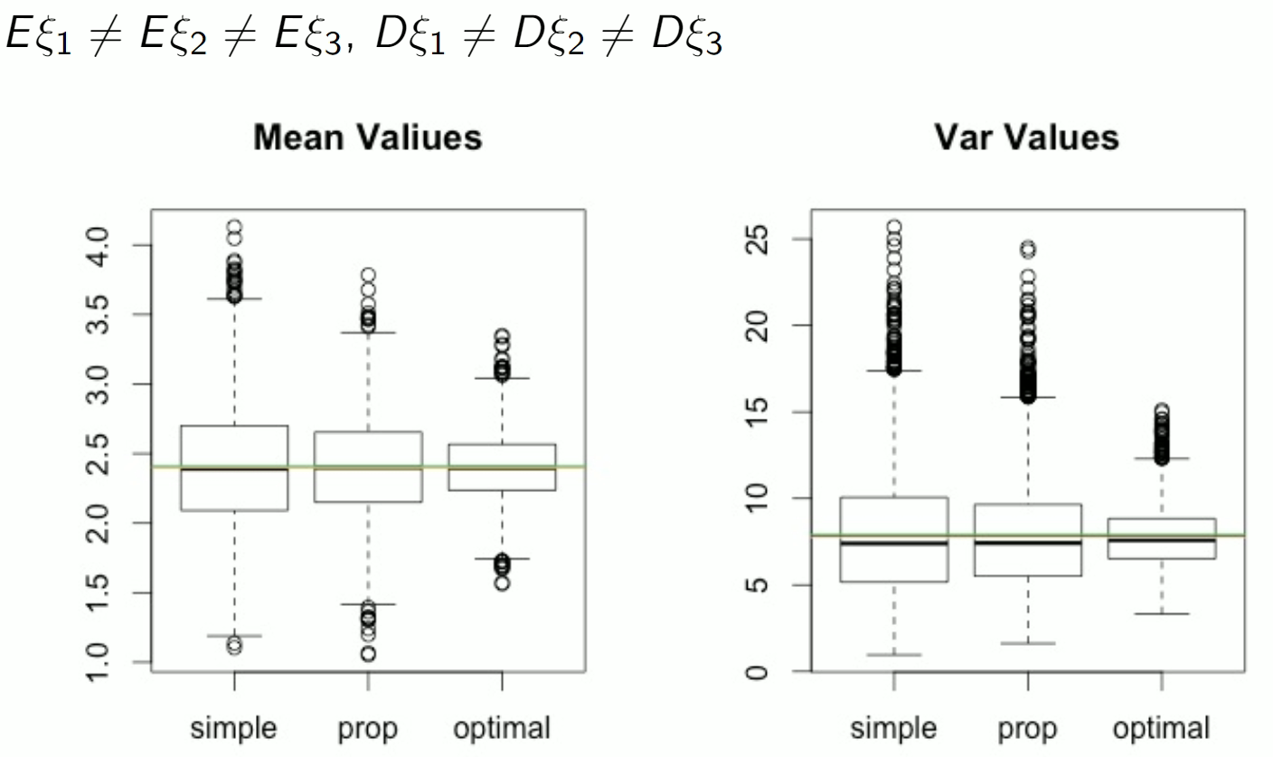
3. Different EV and different variances:

Slide 15
Summary of boxplots:
Optimal sampling helped to generate samples with lower sample mean variance;
Thus the interquartile range is lower both for sample variance and sample mean;
But if the stratas’ EV and Variances are equal, there is no such an advantage.

